Slide 1
Federal Audit Executive Council FY2019 DATA Act Common Methodology Workshop
February 15, 2019

Slide 2
Questions?
DATA Act Mailbox - DataAct@oig.treas.gov

Slide 3
INTRODUCTION

Slide 4
Overview
Digital Accountability and Transparency Act of 2014 (DATA Act)
Requires Federal agencies to report financial and award data in accordance with the established Government-wide financial data standards
Requires IGs to:
Review a statistically valid sample of the spending data submitted by its Federal agency
Submit to Congress and make publically available a report assessing completeness, timeliness, quality, and accuracy of the data sampled; and implementation and use of Data Standards by the Federal agency

Slide 5
Overview
Federal Audit Executive Council (FAEC) DATA Act Working Group
Assist the IG Community in understanding and meeting its DATA Act oversight requirements
Established January 2015 and has over 224 members from over 50 IGs
Published the DATA Act Readiness Review Guide (December 2015) and the first iteration of the Inspectors General Guide to Compliance Under the DATA Act (February 2017)
Currently consists of a Common Methodology Sub-group and a Governance Sub-group

Slide 6
Overview
Results of 2017 Audits
Over 50 IGs issued reports
Majority conducted performance audits
Approximately 72 percent of the audits concluded that agency data was incomplete, inaccurate, not timely, and not of quality
Issues with Treasury’s DATA Act Broker impacted testing results
Comparing the results of IG reports was difficult
Identified and addressed lessons learned
Revised the Inspectors General Guide to Compliance Under the DATA Act

Slide 7
Purpose of the Guide
Provide the IG community with a baseline framework for the audits required by the DATA Act
Audit team should adhere to the overall methodology, objectives, and audit procedures outlined
Audit team can modify the guide based on specific systems and controls in place at its agency but must use professional judgment when designing alternative audit procedures
Strongly recommend that audit teams document the reason for any deviation from the guide in the audit documentation
Guide may be updated based on feedback from the IG community after its issuance

Slide 8
Significant Changes
Scope and Methodology
Revised Definitions
Updated Guidance
Testing Spreadsheet Tool
D1 Crosswalk
Federal Shared Service Providers (FSSP)
Reporting

Slide 9
Audit Objectives
Assess the completeness, accuracy, timeliness, and quality of the financial and award data submitted for publication on USASpending.gov; and
Assess Federal agency’s implementation and use of the Government-wide financial data standards established by OMB and Treasury.

Slide 10
SESSION 1
Audit Scope and Methodology
Data Quality Plans
Internal Controls

Slide 11
Audit Scope and Methodology

Slide 12
Scope and Methodology
First Quarter Fiscal Year 2019
Performance Audits
Obtain an Understanding
Review Data Quality Plan (DQP)
Review Relevant Criteria
Review and Reconcile Data Submitted
Review a Statistically Valid Sample
Review and Assess Internal Controls

Slide 13
Data Quality Plans

Slide 14
Data Quality Plans
A New Requirement
Key Elements
Agency Guidance
IG Review of Agency Data Quality Plans

Slide 15
Data Quality Plans – A New Requirement
On June 6, 2018 OMB issued M-18-16 which is an update to the requirements of A-123
Agencies must develop a Data Quality Plan (DQP) to achieve the objectives of the DATA Act.
DQP must be reviewed and assessed annually for three years or until the agency determines that sufficient controls are in place to achieve the reporting objective.
Quarterly certifications of data submitted by Agency Senior Accountable Officials (SAO) should be based on the consideration of the DQP and the internal controls documented in their plan.

Slide 16
Data Quality Plan – A New Requirement
“Consideration of this plan must be included in agencies’ existing annual assurance statement over internal control over reporting (ICOR) beginning in fiscal year 2019 and continuing through the statement covering fiscal year 2021 at a minimum, or until agencies determine that they can provide reasonable assurances over the data quality controls that support achievement of the reporting objective in accordance with the DATA Act.”
-OMB M-18-16 (Appendix A to OMB Circular No. A-123)

Slide 17
Data Quality Plans - Key Elements
DQPs Should Include Significant Milestones and Decisions About:
Organizational structure and key processes providing internal controls for spending reporting.
Management’s responsibility to supply quality data to meet the reporting objectives for the DATA Act in accordance with OMB Circular No. A-123.
Testing plan and identification of high-risk reported data, including specific data the agency determines to be high-risk that are explicitly referenced by the DATA Act.
Actions taken to manage identified risks.

Slide 18
Data Quality Plan Guidance
Data Quality Playbook
Issued November 30, 2018 by the Chief Financial Officers’ Council
Is a collection of examples and use-cases agencies have proposed based on agency-specific risk assessments at a given time.
Is designed to provide practical information and helpful scenarios for agencies.
Is NOT all inclusive (does not address all potential situations an agency may face with respect to DATA Act implementation)

Slide 19
IG Review of Agency Data Quality Plans
Audit Teams Should:
Review short-term and long-term implementation plans related to the development of the agency’s DQP.
Determine whether the agency has developed a timeline/milestone for developing the DQP.
Evaluate whether the roles and responsibilities for developing the plan are clearly defined (organizational structure).
Determine whether the DQP was considered during the FY 2019 quarterly SAO certifications.
Review documentation of discussions or consideration of the DQP during this certification process.

Slide 20
IG Review of Agency Data Quality Plans
Audit Teams Should (cont’d):
Determine whether the DQP documents the agency’s process for identifying and assessing risks related to spending data.
Determine whether the DQP documents a testing plan and identification of high-risk reported data.
Determine whether the DQP identifies risk of misreported data, the impact of the risk, and how and when those risks identified will be addressed.

Slide 21
Internal Controls

Slide 22
§ 300 – Assessment of Internal Controls
Data Submission and Source Systems
Spending Data
Certification of Quarterly submissions
Other Controls

Slide 23
Controls - Data Submissions and Sourced Systems
Audit Teams Should:
Assess the design of internal and information system controls related to extracting data from the source systems and reporting data to the Broker to ensure they are properly designed, implemented, and operating effectively.

Slide 24
Controls - Data Submissions and Sourced Systems (Cont’d)
To Accomplish This, Audit Teams Should:
Obtain an understanding of internal and information system controls for extracting data from source systems and reporting data to the Broker.
Review and follow-up on data act audit readiness review (if applicable) and prior audit to determine if any system changes and/or corrective actions implemented.
Review the agency's DQP (if one exists)to determine if key controls/processes have been identified for related DATA Act source systems and reporting.
Review the agency's ERM risk profile (if one exists)to determine if the agency identified any risks related to the controls over the DATA Act source systems and reporting.

Slide 25
Controls - Data Submissions and Sourced Systems (Cont’d)
Determine the level of reliance on internal controls and sourced systems: Obtain, review, and consider the agency’s management assertions as established in statues, regulations, and OMB guidance (A-123). For example:
Review the annual assurance statements as required by FFMIA to determine if any agency reported weaknesses/deficiencies in internal controls over operations or internal reporting.
Review management’s annual certification statement as required by FFMIA to determine if financial management systems are in compliance with FMFIA; and
Assess the impact of any control issues identified on the reporting of financial and award data in accordance with the DATA Act.

Slide 26
Controls – Spending Data
Assess whether adequate controls exist to ensure accuracy of spending data (standard data elements).
To Accomplish This, Audit Teams Should :
Review the agency's DQP (if one exists), ERM risk profile, A-123 internal control assessments, and/or other related documentation to determine whether:
key controls/processes have been identified for ensuring spending data is accurate, complete, validated
the agency’s process for identifying and assessing risks related to spending data; and
the agency has identified any high risks data elements, any material weaknesses, as well as corrective actions planned or implemented

Slide 27
Controls – Quarterly Certification Process
CPE#63
Audit Teams Should:
Review and assess whether the agency has an effective certification process to ensure DATA Act files submitted for publication on USASpending.gov are complete, accurate, timely, and of quality.

Slide 28
Controls – Quarterly Certification Process (Cont’d)
To Accomplish This, Audit Teams Should:
Obtain its agency’s certification, validation, reconciliation reports, as well as Broker warnings and error reports, and any other relevant supporting documentation used in providing assurance over its quarterly data submission and perform the following:
Review and assess the agency’s process for reconciling and validating its DATA Act submission.
Determine whether it identifies any deficiencies in internal control or other limitations that would prevent the SAO from certifying that the data submitted for publication on USASpending.gov.
Determine how Broker warnings and errors are addressed to ensure data reported is accurate and certifiable.

Slide 29
Other Internal Controls
Audit Teams Should:
Review and assess the agency’s process for assuring controls are in place to verify current registration of awardees in SAM at the time of the award, and that the process complies with OMB Circular No. A123, Appendix A.
Consider work performed by IGs related to their Federal Shared Service Provider internal controls and agency complimentary controls as it relates to the extraction of data from their source systems, reporting of data to the DATA Act Broker or transmittal of data to their customer for them to report to the DATA Act Broker (See Section 600).

Slide 30
Relying on the Work of Others
Depending on the nature of the work performed, the audit team may also rely on internal control and substantive testing performed by other auditors related to its agency, e.g. financial statement audits.
If other auditors perform internal control testing, Audit Teams Should:
Consult GAGAS when devising its approach to rely on the work of others.
Determine whether testing is sufficient in scope and the tests performed achieve the objectives of this audit.
Note: The nature and extent of evidence needed will depend on the significance of the other auditor’s work to the current objectives and the extent to which the audit team will use that work.

Slide 31
Summary - Internal Controls
Audit Teams must exercise professional judgment when considering:
The extent to which the internal controls of information systems and processes related to the DATA Act can be relied upon.
The source of support for testing individual attributes in the agency’s DATA Act submission in Section 500.
The Need and design of alternate procedures.

Slide 32
Implementation and Use of Data Standards
Audit Teams should:
Review the agency’s data inventory/mapping for Files A thru D1 and D2
Identify appropriate source systems where data resides and identify gaps
Determine the impact of gaps on timeliness or implementation of the data standards
Determine whether agency has consistently used the OMB and Treasury established data elements
Consider results of detailed test work

Slide 33
SESSION 2
Revised Definitions
Sampling Methodology

Slide 34
Revised Definitions, and Sampling Methodology

Slide 35
Learning Objectives
Understand the revised definitions for completeness, accuracy, timeliness, and quality.
Understand the sampling methodology

Slide 36
Revised Definitions – Section 510
Completeness of Agency Submission
Timeliness of Agency Submission
Completeness of Data Elements
Accuracy of Data Elements
Timeliness of Data Elements
Quality

Slide 37
Completeness of Agency Submission
Completeness of Agency Submission
Transactions and events that should have been recorded are recorded in the proper period.
File A
File B
File C

Slide 38
Timeliness of Agency Submission
Timeliness of Agency Submission
Reporting of the Agency DATA Act submission to the DATA Act Broker is in accordance with the schedule established by the Treasury DATA Act Project Management Office (PMO).

Slide 39
Data Elements
Completeness
For each of the required data elements that should have been reported, the data element was reported in the appropriate Files A through D2.
Accuracy
Amounts and other data relating to recorded transactions have been recorded in accordance with the DAIMS RSS, IDD, and the online data dictionary, and agree with authoritative source record.
Timeliness
For each of the required data elements that should have been reported, the data elements were reported in accordance with the reporting schedules defined by the financial, procurement and financial assistance requirements (FFATA, FAR, Federal Procurement Data System – Next Generation (FPDS-NG), Financial Assistance Broker Submission (FABS) and DAIMS).

Slide 40
Completeness of Data Elements
First determine if the data element is required to be reported.
If required, is something there?
If not required then it would not be applicable.

Slide 41
Accuracy of Data Element
Is it consistent with the authoritative source record?
Is it reported according to the requirements in the DAIMS RSS, IDD and the online data dictionary?
A Crosswalk for File D1 is referenced in the Guide (See Appendix 5) that includes authoritative sources for procurement-related data elements.

Slide 42
Accuracy of Data Elements
CPE#04
Optional Data Elements
If reported, must test for accuracy
If not reported, accuracy is considered not applicable
Errors not attributable to the agency such as Third-party systems (like Treasury’s Broker or GSA)
Must be tested for accuracy
Results can be summarized and described separately in the report.
Keep track of dollar-value errors to provide context to any dollar-related data elements. (not projectable)

Slide 43
Timeliness of Data Elements
File C - Award financial data elements should be reported within the quarter in which it occurred.

Slide 44
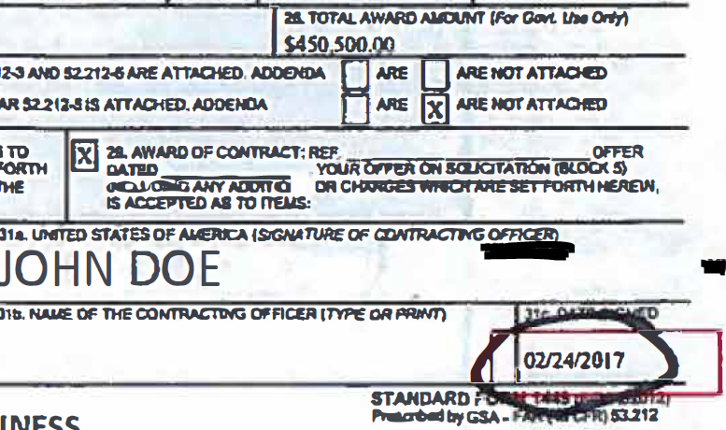
Timeliness of D1 Data Elements
File D1 - Procurement award data elements should be reported in FPDS-NG within 3 business days after contract award in accordance with the FAR Part 4.604.

Slide 45
Timeliness of D1 Data Elements

Slide 46
Timeliness of D2 Data Elements
File D2 - Financial assistance award data elements, should be reported no later than 30 days after award, in accordance with FFATA.

Slide 47
Quality
Quality
Data that is complete, accurate, and provided on a timely basis.

Slide 48
Statistical Sampling Methodology - Section 560
Select a statistically valid sample, preferably from File C (or D1/D2, if file C is not available or determined not suitable for testing).
Criteria:
Confidence level – 95%
Sample Precision –5%

Slide 49
Statistical Sampling Methodology
Expected Error Rate – will be determined based on:
Results of the November 2017 and any subsequent testing of DATA Act information.
Additional information that the OIG has accumulated related to the agency’s internal controls and corrective actions from previous audits.
If more than one error rate was determined in prior audits, the error rate closest to 50% should be used.
If this is a first year audit of the DATA Act submission and there is no previous testing with which to accurately estimate the expected error, then the expected error rate should be set at 50%.

Slide 50
Statistical Sampling Methodology
Sample Size –The sample size will vary by agency but should be no more than 385 records. Auditors should discuss with statisticians the need for replacement sample items.
Sample Unit - The statistical sample should be selected and tested by record. A record is considered a row in the data file within File C. A record could be a portion of a transaction or award activity and not necessarily the whole transaction or award activity.

Slide 51
Statistical Sampling Methodology
Three Overall Error Rates
Completeness
Accuracy
Timeliness
No Longer a Pass/Fail Analysis by Record

Slide 52
Calculating the Overall Error Rates
Calculate three average error rates for each record based on the number of data elements that should have been reported (including optional data elements chosen to be reported by the agency).
Example: We looked at 46 Data Elements
Average Error Rate Calculation for Completeness for Record 1
22/44 = .5 x 100 = 50%
Record 1 has:
44 data elements that should have been reported
Two data elements are not applicable
22 data elements were not complete.
Notes:
Section 580.06

Slide 53
Calculating the Overall Error Rates
To calculate the overall error rates, the average rates of error by record will be averaged over the total number of sample items tested.
This is the calculation for the results below:
Overall Error Rate Calculation for Completeness
(50+20+0)/3 = 23%
Record 1 – 50% Error Rate for Completeness
Record 2 – 20% Error Rate for Completeness
Record 3 – 0% Error Rate for Completeness
Notes:
Section 580.06

Slide 54
Calculating the Overall Error Rates
 |  | Completeness
Average Error Rate |  | DE 1 | DE 2 | DE 3
 | Record 1
 | Record 2
 | Record 3
Overall Error Rate

Slide 55
Three Overall Error Rates
What do we do with the overall error rates?
Statistically Project the Results to the Population
Determine Quality

Slide 56
Statistical Projections
Consult your statistician to perform the statistical projections for each of the three overall error rates.

Slide 57
Determining Quality Based on Statistical Sampling Results
Identify the highest midpoint of the projected error rates and categorize based on the following:
0-20% - Higher Quality
21-40% - Moderate Quality
41% or more – Lower Quality
Notes:
Section 580.07

Slide 58
Determining Quality Based on Statistical Sampling Results
Example:
Completeness: 23% Projected Error Rate +/- 5%
Accuracy: 30% Projected Error Rate +/- 5%
Timeliness: 0% Projected Error Rate +/- 5%
Identify: the highest error rate: Accuracy of 30%
Categorize: Between 21-40% so it’s Moderate Quality

Slide 59
Determining Quality Based on Statistical Sampling Results
Example:
Completeness: 19% Projected Error Rate +/- 10%
Accuracy: 20% Projected Error Rate +/- 10%
Timeliness: 10% Projected Error Rate +/- 10%
Identify: the highest error rate: Accuracy of 20%
Categorize: Between 0-20% so it’s of Higher Quality

Slide 60
Determining Quality Based on Statistical Sampling Results
Example:
Completeness: 0% Projected Error Rate +/- 5%
Accuracy: 46% Projected Error Rate +/- 5%
Timeliness: 0% Projected Error Rate +/- 5%
Identify: the highest error rate: Accuracy of 46%
Categorize: 41% or more so it’s of Lower Quality

Slide 61
SESSION 3
Sample Testing
Testing Spreadsheet Tool

Slide 62
Sample Testing

Slide 63
Testing Overview
DATA Act elements will be evaluated for completeness, accuracy, and timeliness based on their definitions in the Guide.
Consult crosswalks for File D1 (Appendix 5 of the Guide) for authoritative source information

Slide 64
Testing Overlapping / Embedding
While data elements will be tested independently, there will be overlap among the three criteria.
If an element is NOT complete, it is also NOT accurate
If an award was not posted in FPDS by the DATA Act Broker submission date for that quarter, there will be NO matching File D1. In that case, all File D1 elements that should have been reported for that sample transaction will be incomplete, inaccurate, and untimely.

Slide 65
Other Testing Scenarios
If an award posted into FPDS late according to FAR Regulations, then the File D elements for that sample transactions will all be untimely, but may still be complete and accurate.
If an optional data element is incorrectly reported, it is counted as an error.
An error due to DATA Act Broker or external systems (i.e. FPDS) is counted as an error.

Slide 66
Testing Spreadsheet Tool - Benefits
Promotes Uniformity Among IGs
Improves Efficiency in Reporting
Simplifies GAO Roll-Up of Overall Results
Captures Testing Required per the Guide (Sections 570 and 580)
Recommended, but Not Required

Slide 67
Testing Spreadsheet Tool - Layout
CPE#45
Composed of Four Main Tabs
Instructions
PIID Testing
FAIN Testing
Summary PIID and FAIN Results

Slide 68
Testing Tabs Specifications
Data Points are ONLY recognized as follows:
1 = Exception (Incomplete, Inaccurate, Untimely)
0 = No Exception (Complete, Accurate, Timely)
n/a = Not Applicable
Columns should not be added or deleted (to maintain integrity of horizontal formulas)
Rows can be added and deleted for different sample sizes(Go to Review Tab, and ‘Unprotect Worksheet’)

Slide 69
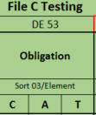
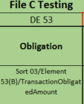
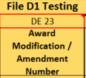
Testing Tabs Specifications
‘Missing or Invalid’ column will alert the user of any unrecognized data or unpopulated cells in the testing range
Contains locked formulas (with exceptions)
Row 5 can be expanded for reference(s) to location of data element in DAIMS IDD (includes sub-elements)
Comments are included in selected cells
Red borders indicate potentially “Not Applicable” data elements

Slide 70
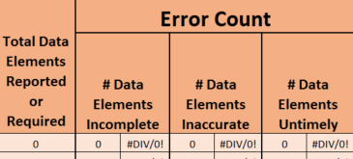
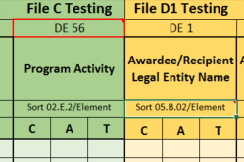
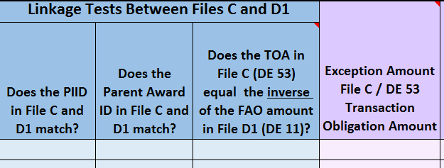
Testing Tabs - PIID and FAIN Testing
Contain Three Main Sections
Results Calculations and Reference(Far Left)
Statistical Testing (Middle)
Non-Statistical Testing (Far Right)

Slide 71
Summary PIID and FAIN Results Tab
Brings forward results from PIID and FAIN testing tabs
Rows will need to be added/deleted based on sample size
Agencies are responsible for ensuring proper linkage to PIID and FAIN testing
Provides basis for statistical projection

Slide 72
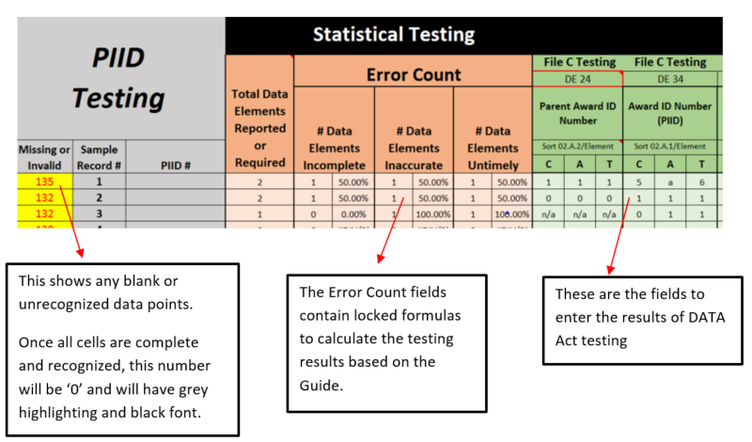
PIID and FAIN Testing Exhibit

Slide 73
Demonstration of Testing Spreadsheet Tool

Slide 74
Testing Spreadsheet Tool- Demo
During this Demo, we will go over the following:
Customization of Tool for Sample Size
Protection (which cells are protected)
Population of Selected Elements
Explanation of Formulas
Functionality of Missing/Invalid Alert column

Slide 75
Testing Spreadsheet Tool- Demo Recap
Accommodate Sample - Temporarily unprotect worksheet, add and delete rows, and adjust control #s
Populate PIID Column - With sample transaction information.
Record Results - For completeness, accuracy, and timeliness.
Confirm Full Population - Missing/Invalid Column shows ‘0’
Link - Results to summary tab.

Slide 76
Reminder – Adding & Deleting Rows
1) Go to Review Tab and select ‘Unprotect Sheet’
2) Add or delete rows and copy formulas from original rows
3) Go to Review Tab and select ‘Protect Sheet’

Slide 77
Reminder - Scoring Results

Slide 78
SESSION 4
Federal Shared Service Providers
Report Content Panel

Slide 79
Federal Shared Service Providers (FSSP)

Slide 80
Federal Shared Service Providers
Background
OMB M-13-08
Improve transparency & consistency of financial data across Federal agencies
Reduce exposure to risks in cost, quality and performance
Focus on fewer, standardized solutions operated by more experienced staff

Slide 81
Federal Shared Service Providers
Background (Cont’d)
OIG DATA Act audit-specific concerns
Coordination with FSSP
Tracking FSSP status and internal controls
Service agreements - MOUs and IAAs
FSSP Customer Engagement
FSSP and Agency Coordination
Resolution of assistance request processes
Agency representation in FSSP governance structure

Slide 82
FSSP Audit Steps
Section 610 – Shared Service Customer OIG
Perform steps in conjunction with other guide steps
Note: This is a guide ▬ Use appropriate review procedures

Slide 83
FSSP Audit Steps (Cont’d)
Communicating Findings
Convey any concerns to Agency SAO
Agency OIG share any concerns about error rates attributable to FSSP with FSSP IG and GAO
FSSP’s OIG to provide POC to Customer Agencies’ OIGs
Concerns included in FSSP OIG “Other Matters” Section

Slide 84
FSSP Audit Steps (Cont’d)
Establish and Document Roles and Responsibilities
Determine the Agency’s use of FSSP in Implementing DATA Act
Ensure DATA Act reporting roles and responsibilities
Established between customer agencies and FSSP
Documented Service agreements - MOUs and IAAs
Governance Structure and Representation
Determine if customer agencies have representation
Determine if customer agencies are members of FSSP’s Data Act working group

Slide 85
FSSP Audit Steps (Cont’d)
Example: MOU Terms and Conditions
DATA Act Preparation Support
<Your FSSP> will prepare the data file and upload it to the Broker.
<Your FSSP> will also research the “warning messages” and correct any errors related to transactional data within the DATA Act submission files.
<Your Agency> is responsible for ensuring all applicable information is appropriately reported to FPDS and USA Spending in order to certify the files directly in the Broker; and
<Your Agency> is responsible for reconciling PIIDs/FAINs where they don’t match FPDS/USA Spending and MSA.

Slide 86
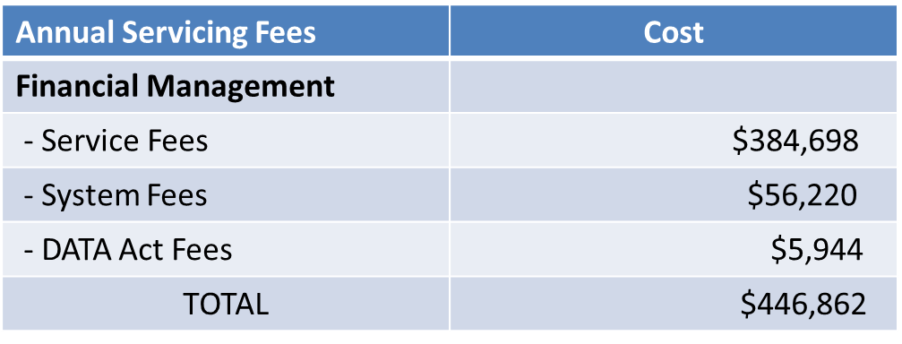
FSSP Audit Steps (Cont’d)
Example: IAA Specified Costs
The cost of services outlined in this IAA is $446,862 for the IAA period of performance

Slide 87
FSSP Audit Steps (Cont’d)
Determine if customer agency component(s) documented extent of FSSP reporting
Ensure customer agency component(s) understand what financial and non-financial award data will be submitted by FSSP
Determine whether any customer agency component(s) required to submit any additional DATA Act reporting on its own
Ensure that any customer agency component(s) have:
Developed a continued plan to provide the required data and
Communicated the plan to the FSSP

Slide 88
FSSP Audit Steps (Cont’d)
Determine if customer agency component(s) receive notification from the FSSPs of any further business process changes needed
Changes to business processes
Determine if customer agency component(s) are taking necessary actions to implement any further business changes
If the FSSP submits DATA Act information on behalf of the customer:
How does the FSSO make the submission?
How does the agency SAO certify the data?

Slide 89
FSSP Audit Steps (Cont’d)
Internal Controls and Risk Assessment
Use Section 300 of the OIG Audit Guide
Determine if Agency follows the five components and 17 related principles
Assess the Agency customer controls in accordance with the Agency/FSSP MOU or Service Agreement
Review DQP in relation to DATA Act objectives

Slide 90
FSSP Audit Steps (Cont’d)
Assessment of FSSP OIG’s DATA Act Work
If they have performed work:
Inquire after the results of their work and obtain the results up to date of customer IG risk assessment
If they have performed no work:
Document that no work was performed.
If they have plans for work:
Inquire into the steps and amount to avoid duplication of effort
Request FSSP OIGs share audit progress and findings during customer OIG audit activities

Slide 91
FSSP Audit Steps (Cont’d)
Implementation Issues with FSSP
Document
The issues encountered
How the issues were identified and reported
Analyze & Document
Impact of issues on DATA Act compliance
What has been done to mitigate issues

Slide 92
FSSP Audit Steps (Cont’d)
CPE#25
Review of the FSSP SSAE 18 Service Organization Control (SOC Report)
Use GAO/CIGIE’s Financial Audit Manual
Section 640 & 640A
Assess impact of findings
Assess corrective actions if any
Compare data
Submitted to Broker
Exported to Agency systems

Slide 93
Reporting

Slide 94
Reporting
Reports should conform to GAGAS standards and contain the results of the engagement team’s assessment of:
Identified control deficiencies that may adversely impact the completeness, timeliness, quality, and accuracy of the data submitted
Implementation and use of the data standards by the Federal agency

Slide 95
Reporting, Cont’d.
Reports should conform to GAGAS standards and contain the results of the engagement team’s assessment of:
Completeness, timeliness, accuracy, and quality of DATA Act submission.
Results of summary-level testing of Files A and B
Projected Error rates for completeness, accuracy, and timeliness of data sampled
Final determination of data quality
Supplemental (non-projected) reporting of results of data sampled
Data Element Analysis
Analysis of the Accuracy of Dollar Value-related Data Elements
Analysis of Errors in Data Elements Not-Attributable to the Agency

Slide 96
Reporting, Cont’d.
Example: Data Element Analysis
The analysis of results by data elements can be reported using the example in Appendix 8.
The audit team may want to sort the results by error rate to provide the stakeholders with easy to discern information regarding which data elements were determined to have the highest instances of error.
Additionally the report should discuss whether the results are consistent with the risks identified in the agency’s DQP.

Slide 97
Reporting, Cont’d.
Example: Analysis of the Accuracy of Dollar Value-related Data Elements

Slide 98
Reporting, Cont’d.
Example: Analysis of Errors in Data Elements Not Attributable to the Agency

Slide 99
Reporting, Cont’d.
Example: Additional Report Verbiage
DATA Act Date Anomaly
Assessment of DATA Act Submission
Completeness and Timeliness of the Agency’s Submission
Summary-Level Data and Linkages for Files A, B, and C
Record-Level Data and Linkages for Files C and D1/D2
Implementation and Use of the Data Standards

Slide 100
Reporting, Cont’d.
DATA Act reports should be:
Made publicly available on or before November 8, 2019
Distributed to the following:
Senate Committee on Homeland Security and Governmental Affairs
House Committee on Oversight and Reform
Senate Committee on the Budget
House Committee on the Budget
GAO
Treasury OIG

Slide 101
Questions?
DATA Act Mailbox - DataAct@oig.treas.gov

